Slide 1
Combinational Circuits
Igor Smirnov
3 October 2018

Slide 2
Layers of Abstraction in Computer Science (CS)
Application
Algorithms
Programming Language
Operating System
Instruction Set Architecture
Microarchitecture
Gates/Register-Transfer Level (RTL)
Topics of
this lecture
Circuits
Physics

Slide 3
Main Boolean operations
identity
The simplest Boolean operation is …
The second simplest Boolean operation is inversion
x | id x
0 | 0
1 | 1
x
x
x | !x
0 | 1
1 | 0
x
!x

Slide 4
Main Boolean operations
AND (or Boolean multiplication)
AND is often used as a logical key:
NAND
x | y | x*y
0 | 0
0 | 1
1 | 0
1 | 1
x
0
x*y
y
0
0
1
x | y | x*y
0 (closed) | y | 0
1 (open) | y | y
x | y | !(x*y)
0 | 0
0 | 1
1 | 0
1 | 1
1
x
1
!(x*y)
1
y
0

Slide 5
Main Boolean operations
x | y | x+y
0 | 0
0 | 1
1 | 0
1 | 1
OR (or Boolean addition)
0
x
x+y
1
y
1
1
NOR !(x+y)
XOR (or exclusive OR, or addition by module 2)
x | y | x ⊕ y
0 | 0
0 | 1
1 | 0
1 | 1
0
x
x ⊕ y
= x*!y + !x*y
1
y
1
0

Slide 6
Many-input devices
Primitives like OR, AND may be composed to support several inputs
x
x+y
x
y
y
x+y+z+w
x+y+z+w
z
z
z+w
w
w

Slide 7
Combinational Circuits

Slide 8
Boolean functions
Boolean operations can be combined into functions
F(x, y, z) = x + !y*z
x
x + !y*z
x | y | z | F
0 | 0 | 0
0 | 0 | 1
0 | 1 | 0
0 | 1 | 1
1 | … | … | 1
y
0
z
1
0
0

Slide 9
Combinational Circuits
If the output of a function is completely defined by the current input then the function is called combinational :
Qt = F(xt, yt, zt, …)
Combinational circuit (scheme) is an implementation of a combinational function
A lot of things can be implemented using combinational circuits
Just a few examples that will be presented soon: adder, decoder, multiplexer

Slide 10
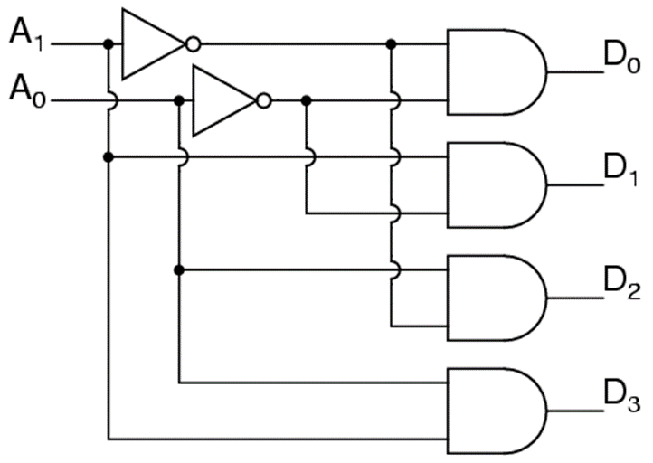
Binary Decoder
A binary decoder is a logic circuit that converts a binary integer value to an associated pattern of output bits.
A₀ | A₁ | D₀ | D₁ | D₂ | D₃
0 | 0 | 1 | 0 | 0 | 0
0 | 1 | 0 | 1 | 0 | 0
1 | 0 | 0 | 0 | 1 | 0
1 | 1 | 0 | 0 | 0 | 1

Slide 11
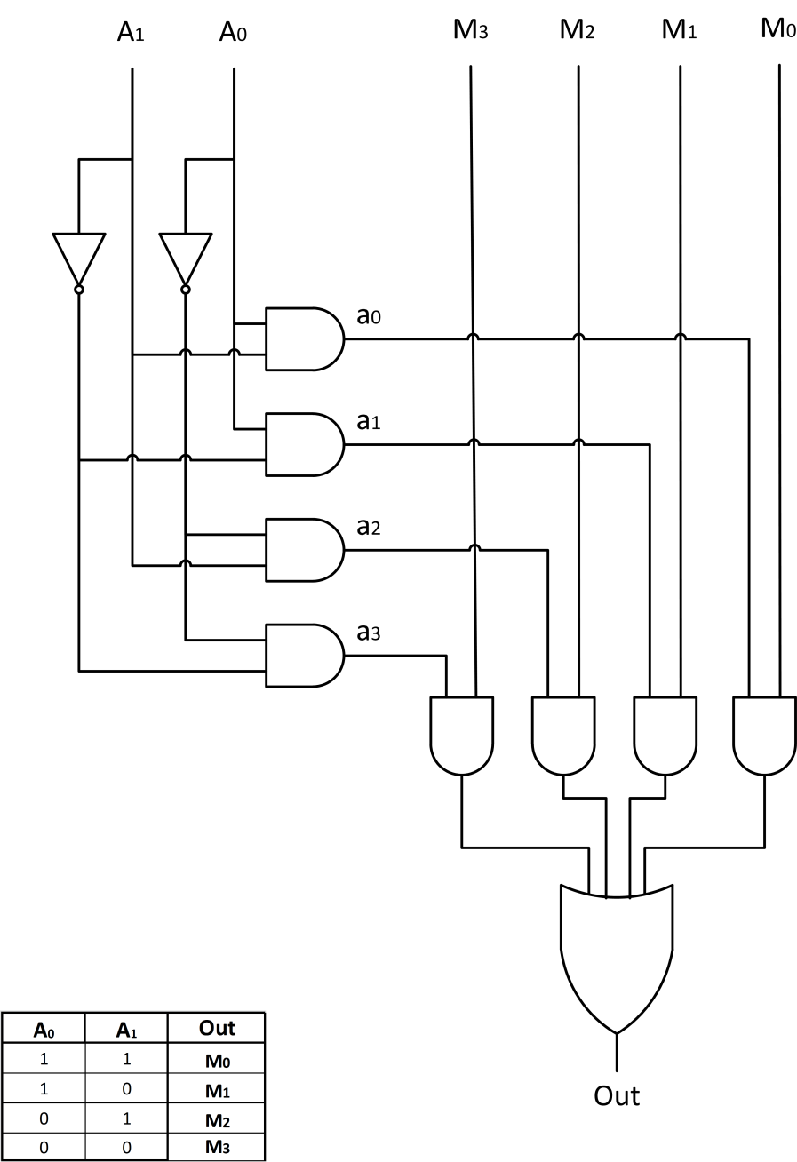
Multiplexer
A multiplexer (or mux) is a device that selects one signals and forwards the selected input into a single line.
The entry wires are address bus and data buses
Address bus is connected via decoder
M₀
M₁
A₀ | A₁ | Out
0 | 0 | M₀
0 | 1 | M₁
1 | 0 | M₂
1 | 1 | M₃
Out
M₂
M₃
A₀
A₁

Slide 12
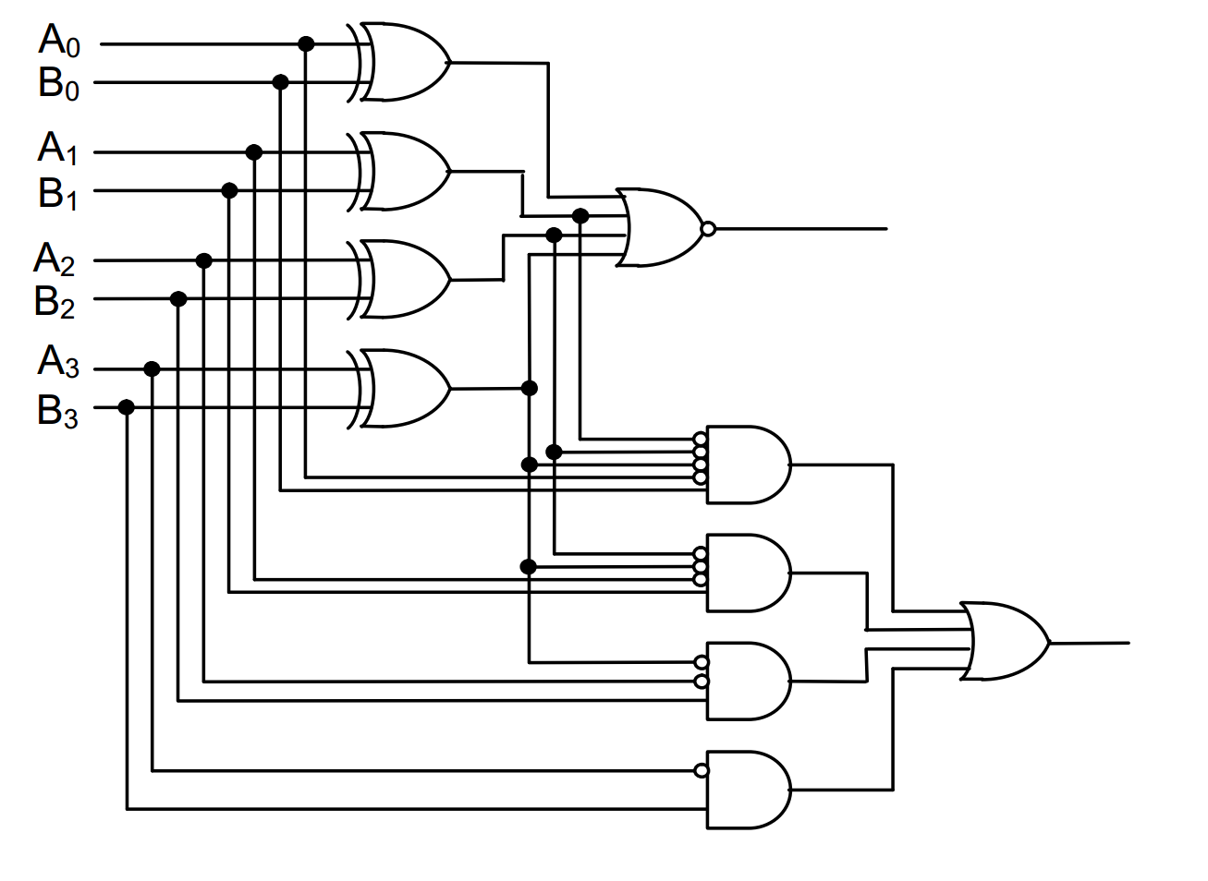
Comparator
A comparator is a device that takes two numbers as input in binary form and determines whether one number is greater than, less than or equal to the other number
 | EQ | LEQ
B<A | 0 | 1
B=A | 1 | 1
B>A | 0 | 0
EQ
LEQ

Slide 13
Adder and ALU

Slide 14
Half adder scheme
It is an adder, but it is not a full adder, because it does not have input carry
It is an adder, but it is not a full adder, because it does not have input carry
x
x | y | s | c
0 | 0
0 | 1
1 | 0
1 | 1
s
y
x
half +
sum
0
0
1
0
y
carry
1
0
0
1
c
Calculations:
Sum =
= !x * y + x * !y =
= x ⊕ y
Carry = x * y

Slide 15
Full adder scheme
We add input carry here
xn | yn | cn-1 | sn | cn
0 | 0 | 0
0 | 1 | 0
1 | 0 | 0
1 | 1 | 0
cn-1
0
0
1
0
half +
1
0
xn
half +
sn
0
1
yn
0 | 0 | 1
0 | 1 | 1
1 | 0 | 1
1 | 1 | 1
1
0
0
1
0
1
c
1
1
Cn
x
+
sum
It is called a full adder
y
carry

Slide 16
Wide adder
We may add more adders to sum numbers wider than 1 bit
yn+1
xn+1
yn
xn
+
+
+
+
+
cn+1
cn
cn-1
sn+1
sn
In real HW, wide adders have more complicated schemes to avoid long “carry chains”

Slide 17
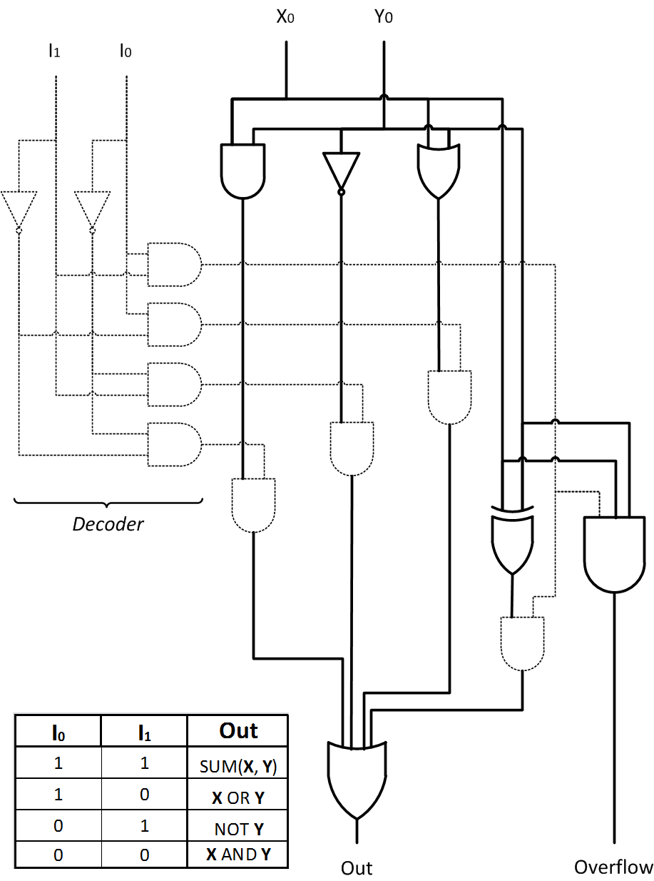
Arithmetic Logic Unit
ALU is a circuit that is able to perform different arithmetic and bitwise logical operations on integer binary numbers
ALU
Operand 1 (X)
Result (out)
Operand 2 (Y)
Opcode (I)

Slide 18
Thank You

Slide 19
Appendix

Slide 20
Critical paths

Slide 21
What is a critical path of scheme?
Critical path is the slowest logic path in the circuit
Reliable result of whole logic path can not be ready until critical path is passed by signal

Slide 22

Example of critical path finding: Multiplexer
= 5t
1t
2t
1t
1t

Slide 23
Subtraction

Slide 24
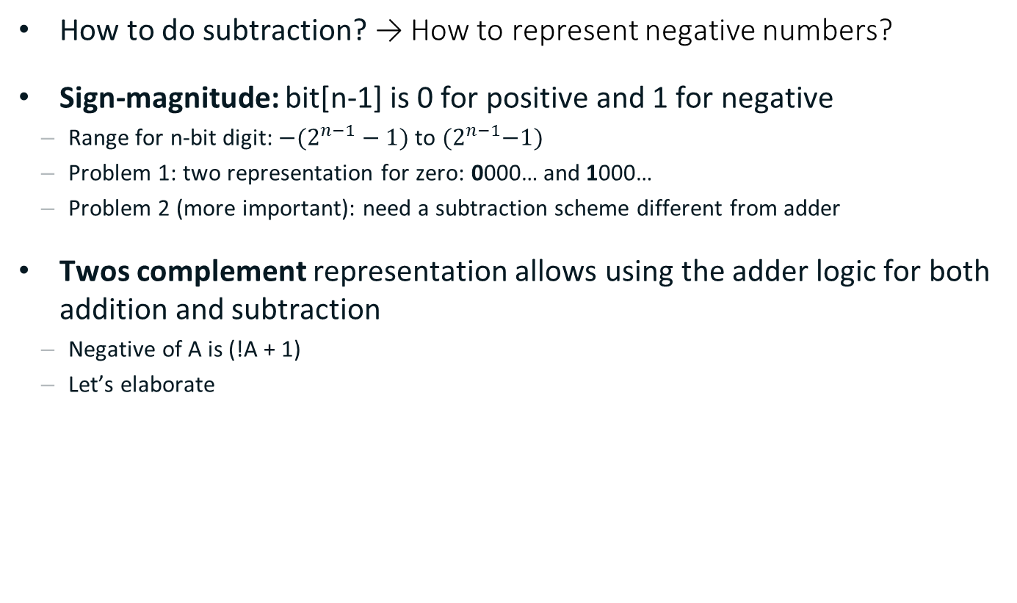
Negative Numbers
How to do subtraction? → How to represent negative numbers?
Sign-magnitude: bit[n-1] is 0 for positive and 1 for negative
Range for n-bit digit: ${−(2}^{n−1}−1)$ to ${(2}^{n−1}−1)$
Problem 1: two representation for zero: 0000… and 1000…
Problem 2 (more important): need a subtraction scheme different from adder
Twos complement representation allows using the adder logic for both addition and subtraction
Negative of A is (!A + 1)
Let’s elaborate

Slide 25
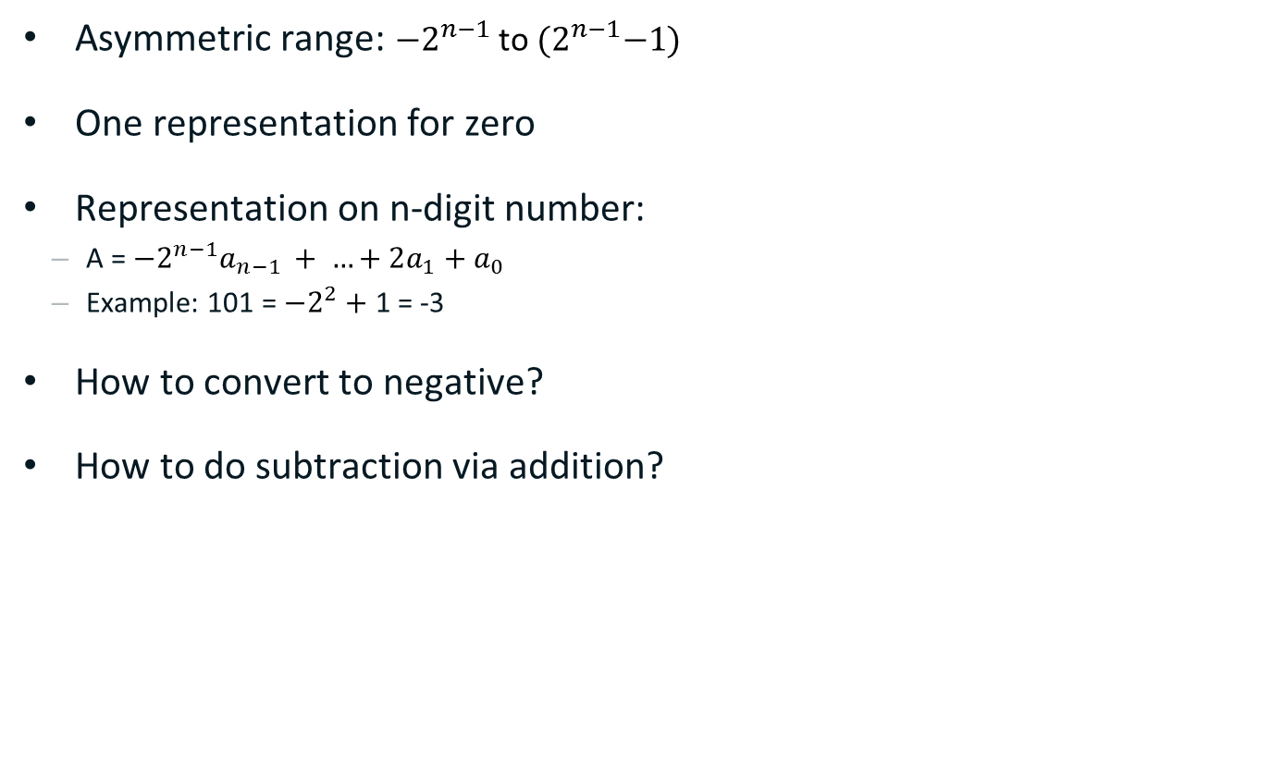
Twos Compliment Representation
Asymmetric range: ${−2}^{n−1}$ to ${(2}^{n−1}−1)$
One representation for zero
Representation on n-digit number:
A = ${−2}^{n−1}a_{n−1 }+ …+2a_{1}+a_{0}$
Example: 101 = ${−2}^{2}+$1 = -3
How to convert to negative?
How to do subtraction via addition?
subtraction
0
addition
-1
000
+1
111
001
-2
110
010
+2
101
011
+3
-3
100
-4
overflow

Slide 26
Example of subtraction (1)
0
Example: 2 – 3 = ?
2 – 3 = 2 + (−3)
2 + (−3) = 010 + 101 = 111
111 = −1
-1
000
+1
111
001
-2
110
010
+2
0
-1
000
+1
101
011
+3
111
001
-3
100
-4
-2
110
010
+2
0
101
011
+3
-1
000
+1
-3
100
111
001
-4
-2
110
010
+2
101
011
+3
-3
100
-4

Slide 27
Example of subtraction (2)
0
Example: −1 – 3 = ?
−1 – 3 = −1 + (−3)
−1 + (−3) = 111 + 101 = 1100
100 = −4
-1
000
+1
111
001
-2
110
010
+2
0
-1
000
+1
101
011
+3
111
001
-3
100
-4
-2
110
010
+2
0
101
011
+3
-1
000
+1
-3
100
111
001
-4
-2
110
010
+2
101
011
+3
-3
100
-4

Slide 28
Overflow
Example: −2 – 3 = ?
−2 – 3 = −2 + (−3)
−2 + (−3) = 110 + 101 = 1011
011 = 3 → Overflow ☹
Overflow conditions
negative + negative = positive
positive + positive = negative
How to check in HW?
If C_{n-1} != C_{n-2} then overflow
0
-1
000
+1
111
001
-2
110
010
+2
0
-1
000
+1
101
011
+3
111
001
-3
100
-4
-2
110
010
+2
0
101
011
+3
-1
000
+1
-3
100
111
001
-4
-2
110
010
+2
101
011
+3
-3
100
-4

Slide 29
Negation
How to convert to negative?
School math: −B = (−1 − B) + 1
What is (−1 − B)?
Thus, −B = !B + 1
Finally:
A − B = A + (−B) = A + !B + 1
000
111
0
001
→ Inversion
−1
+1
-1
1 | … | 1 | 1 | 1
Bn-1 |  | B2 | B1 | B0
–
1 | … | 1 | 1 | 1
Bn-1 |  | B2 | B1 | B0
!Bn-1 |  | !B2 | !B1 | !B0
110
B
−2
+2
010
!B
−3
+3
101
011
−4
100

Slide 30
Add/Subtract Schematic
A − B = A + (−B) = A + !B + 1
of = C_{n-1} ⊕ C_{n-2}
…
y_{n-1}
y₂
y₁
y₀
…
x_{n-1}
x₂
x₁
x₀
c_{n-1}
+
c_{n-2}
…
c₂
c₁
c₀
subtract?
+
+
+
s_{n-1}
s₂
s₁
s₀
of

